Slide 1


Data Science: Principles and Practice
Lecture 1: Introduction
Ekaterina Kochmar¹
________________________________________
¹ Based on slides from Marek Rei

Slide 2
Data Science: Principles and Practice
01
Introduction and motivation
02
Practical basics
03
Course logistics

Slide 3





What is Data Science?
Data Processing
Statistics
Machine Learning
Visuali- zation
Big Data
crawling
cleaning
connecting
measuring analyzing
exploring
modeling predicting simulating
investigating structuring presenting
processing parallelizing optimizing

Slide 4
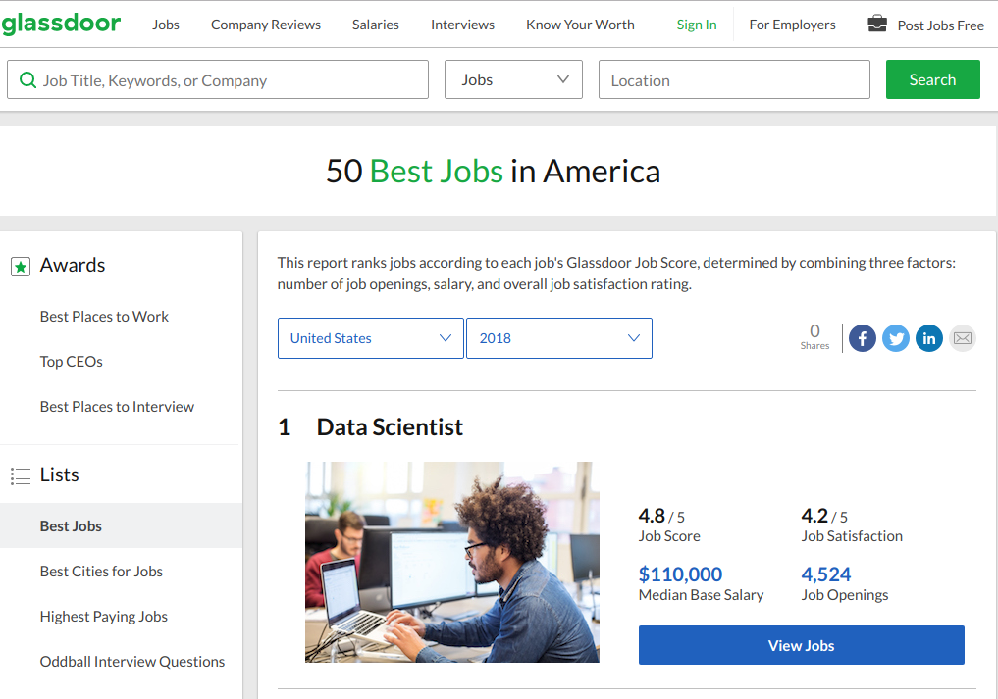
https://www.glassdoor.com/List/Best-Jobs-in-America-LST_KQ0,20.htm

Slide 5
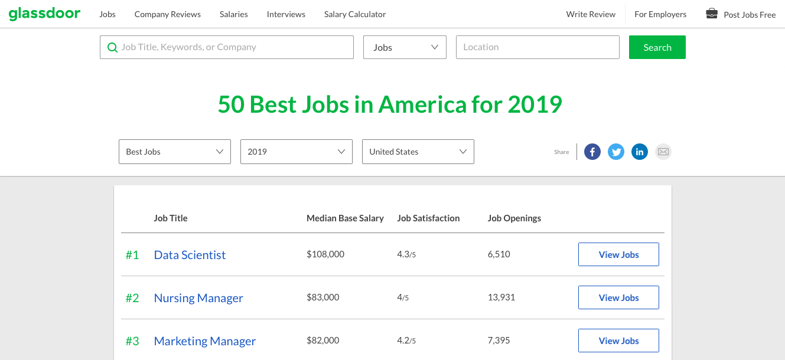
https://www.glassdoor.com/List/Best-Jobs-in-America-LST_KQ0,20.htm

Slide 6
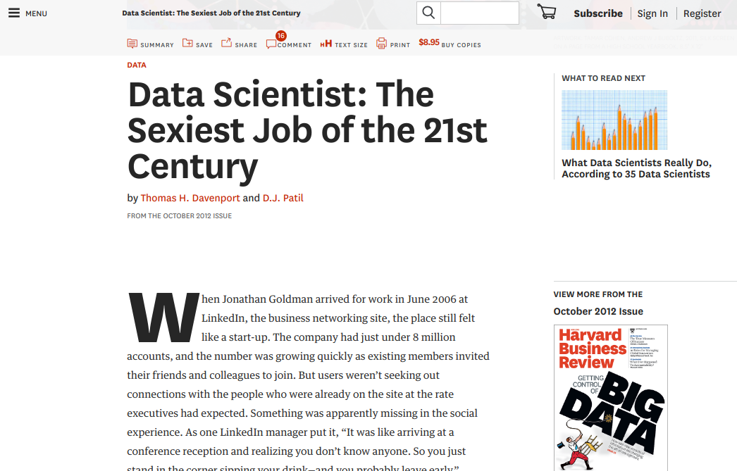
https://hbr.org/2012/10/data-scientist-the-sexiest-job-of-the-21st-century
Notes:
https://hbr.org/2012/10/data-scientist-the-sexiest-job-of-the-21st-century

Slide 7
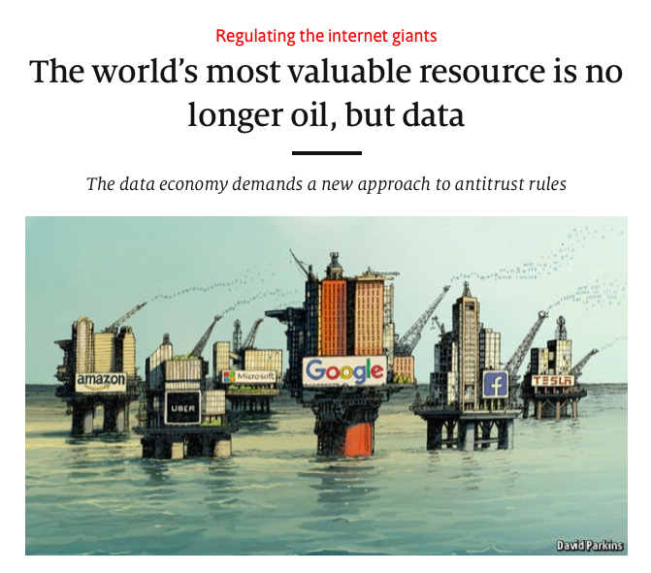
https://www.economist.com/leaders/2017/05/06/the-worlds-most-valuable-resource-is-no-longer-oil-but-data
Notes:
https://hbr.org/2012/10/data-scientist-the-sexiest-job-of-the-21st-century

Slide 8
Case studies
Sports
01
02
Medicine
03
Politics

Slide 9

Data Science in Sports
The market for baseball players was so inefficient…
that superior management could run circles around taller piles of cash.
- Michael Lewis
Legendary 2002 season for Oakland Athletics.
Manager Billy Beane put together an unexpected team using data science.
Notes:
http://adilmoujahid.com/posts/2014/07/baseball-analytics/
Stanford data science course
DePodesta, a graduate in Economics from Harvard University joined the A’s in 1999 and quickly started incorporating analysis of baseball statistics to value and purchase players.(Sabermetrics)
This approach came into the limelight following the historical 2002 season when Billy Beane purchased vastly undervalued players to supplant the departure of key players prior to the start of the season. Due to severe budgetary constraints of the Oakland Athletics, Billy resorted to the methods being researched by DePodesta in order to purchase underrated players to meet the California based team’s payroll.
The Athletics' 2002 campaign ranks among the most famous in franchise history. Following the 2001 season, Oakland saw the departure of three key players. Billy Beane, the team's general manager, responded with a series of under-the-radar free agent signings. The new-look Athletics, despite a comparative lack of star power, surprised the baseball world by besting the 2001 team's regular season record. The team is most famous, however, for winning 20 consecutive gamesbetween August 13 and September 4, 2002.^{[1]} The Athletics' season was the subject of Michael Lewis's 2003 book Moneyball: The Art of Winning an Unfair Game (Lewis was given the opportunity to follow the team around throughout the season). A film adaptation of the book, also titled Moneyball, was released in 2011.

Slide 10
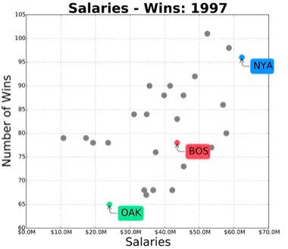
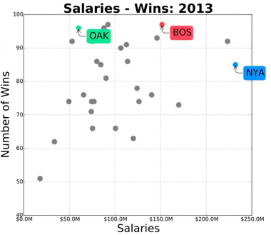
Data Science in Sports
http://adilmoujahid.com/posts/2014/07/baseball-analytics/
Notes:
Oakland Athletics vs Boston Red Sox and New York Yankees
Oakland Athletics won 20 consecutive games

Slide 11
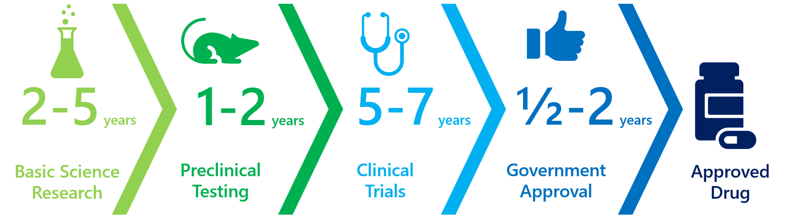
Data Science in Drug Discovery
1:10,000 success rate
1:10 success rate
$350M to $5.5B cost
http://sitn.hms.harvard.edu/flash/2017/make-fda-great-trump-future-drug-approval-process/ https://en.wikipedia.org/wiki/Cost_of_drug_development
Notes:
1 in 10,000 drugs actually makes it through the whole process.
10% chance once it’s in clinical trials
Drug development cost between $350 million and $5.5 billion

Slide 12
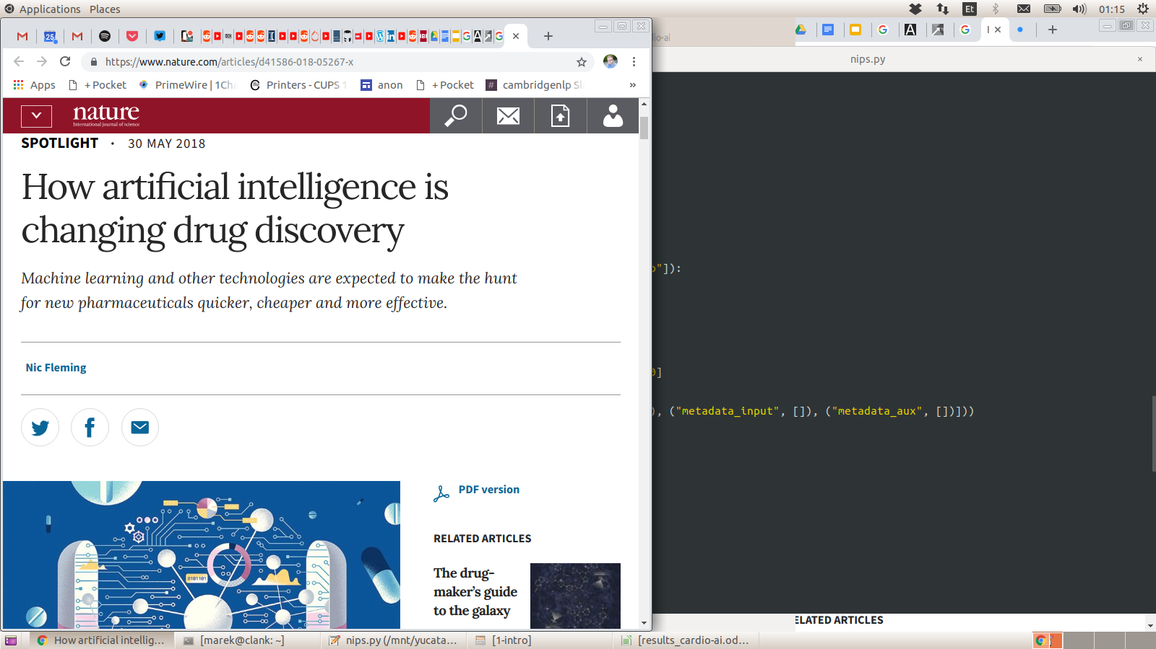
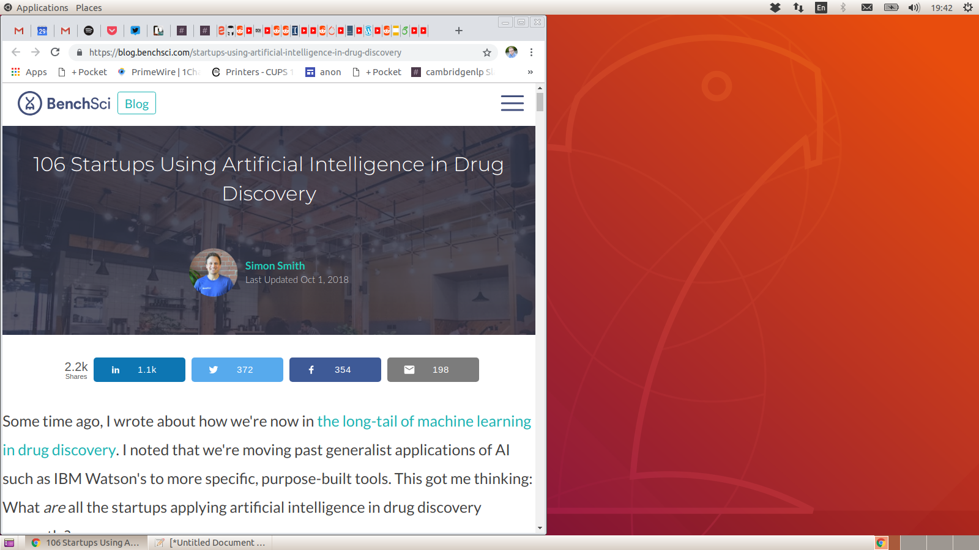
Data Science in Drug Discovery
https://www.nature.com/articles/d41586-018-05267-x
https://blog.benchsci.com/startups-using-artificial-intelligence-in-drug-discovery
Notes:
1 in 10,000 drugs actually makes it through the whole process.
10% chance once it’s in clinical trials
Drug development cost between $350 million and $5.5 billion

Slide 13
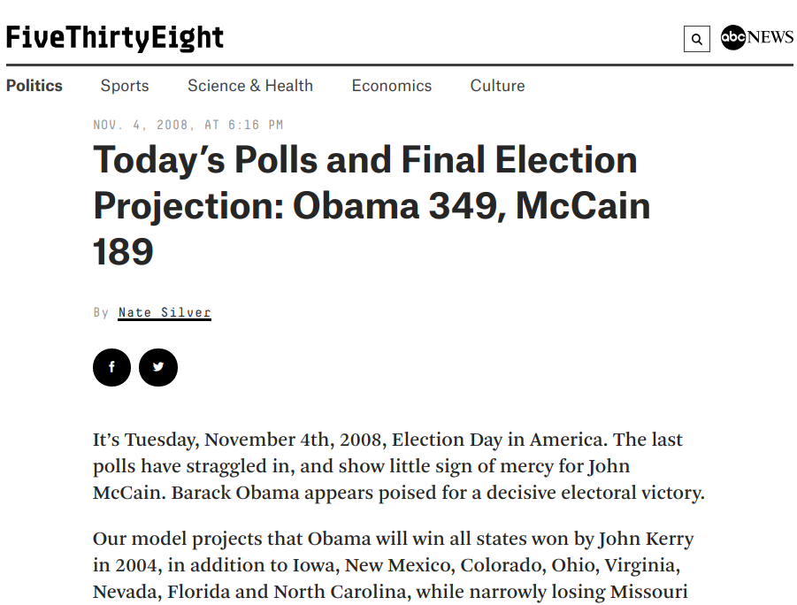
https://fivethirtyeight.com/features/todays-polls-and-final-election/
Notes:
https://fivethirtyeight.com/features/todays-polls-and-final-election/
https://projects.fivethirtyeight.com/2016-election-forecast/

Slide 14
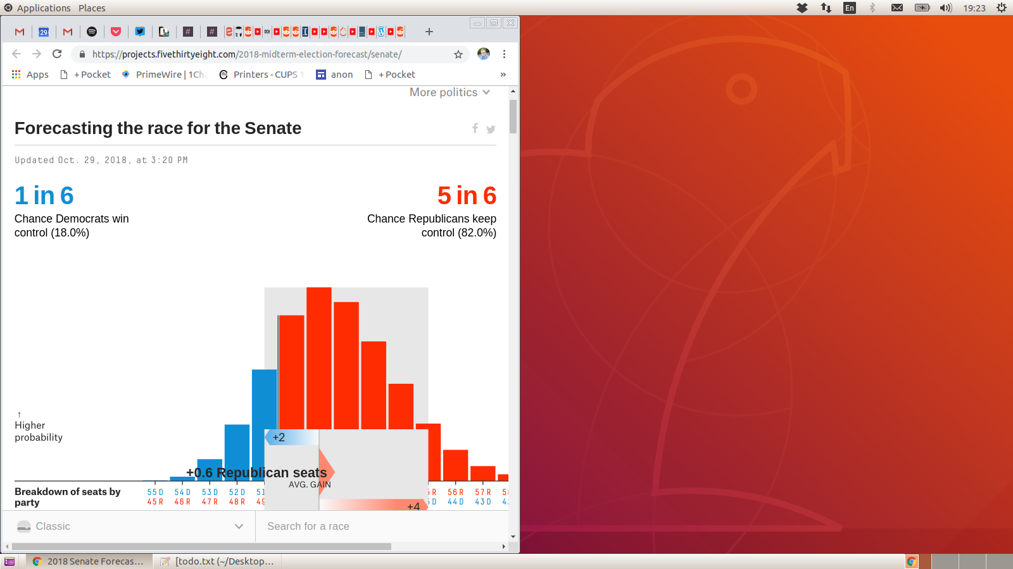
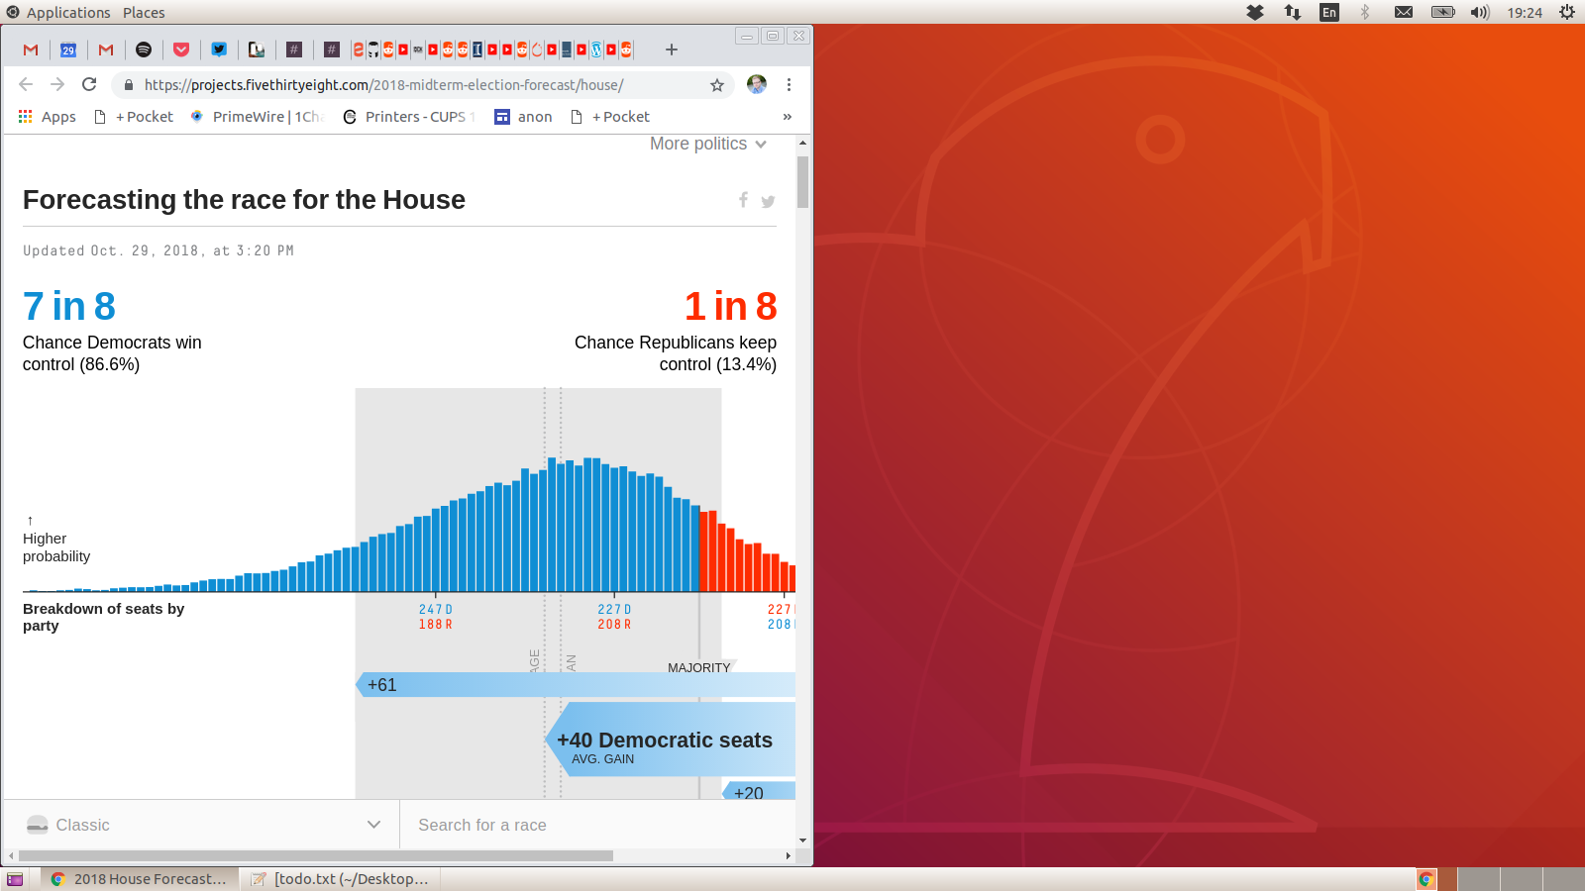
Data Science in Politics
https://fivethirtyeight.com/tag/2018-election/
Notes:
https://projects.fivethirtyeight.com/2018-midterm-election-forecast/house/
https://projects.fivethirtyeight.com/2018-midterm-election-forecast/senate/

Slide 15
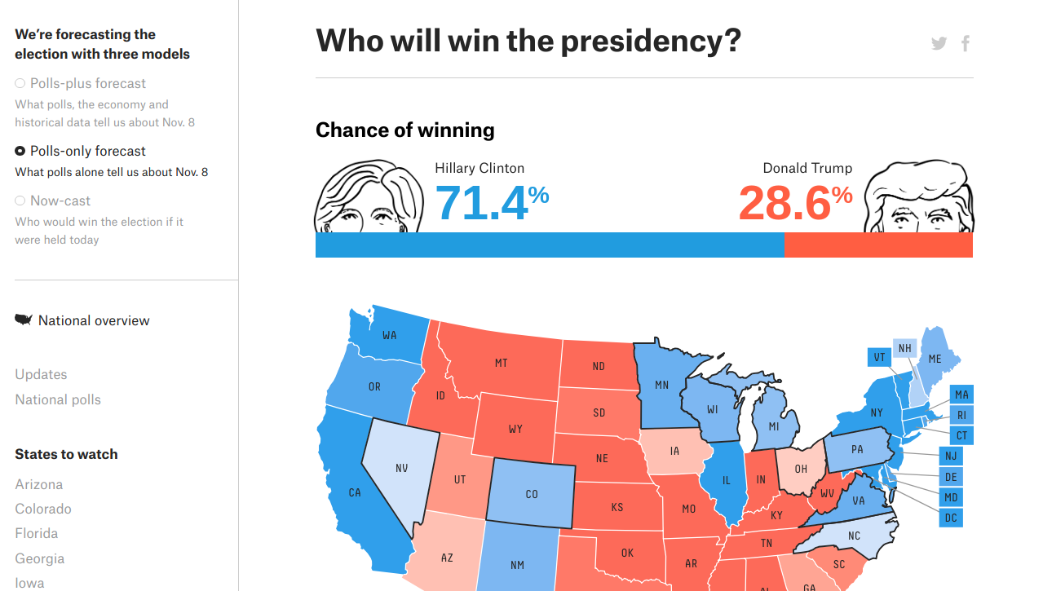
https://projects.fivethirtyeight.com/2016-election-forecast/
Notes:
https://fivethirtyeight.com/features/todays-polls-and-final-election/
https://projects.fivethirtyeight.com/2016-election-forecast/

Slide 16




Data Science in Commerce

Slide 17
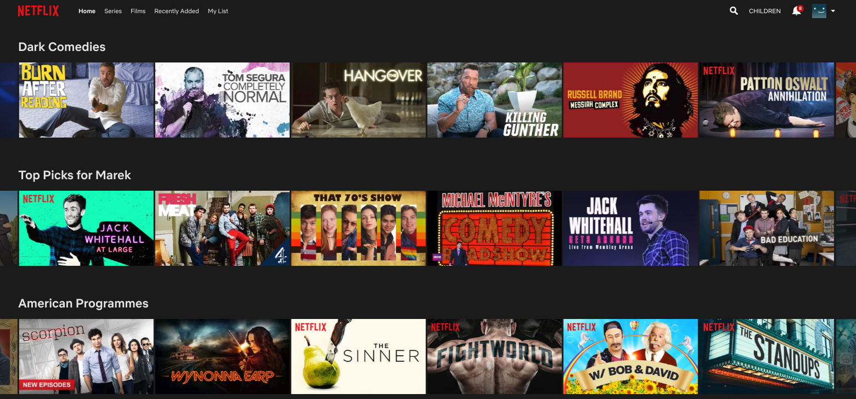
Data Science in Commerce

Slide 18

Netflix Challenge
movie | user | date | score
1 | 56 | 2004-02-14 | 5
1 | 25363 | 2004-03-01 | 3
2 | 855321 | 2004-07-29 | 3
2 | 44562 | 2004-07-30 | 4
3 | 42357 | 2004-12-10 | 1
3 | 1345 | 2005-01-08 | 2
In 2006, Netflix offered 1 million dollars for an improved movie recommendation algorithm.
Provided 100M movie ratings for training.
The goal: Improve over Netflix’s own algorithm by 10% to get the prize.
Several teams joined up and claimed the prize on in 2009.

Slide 19
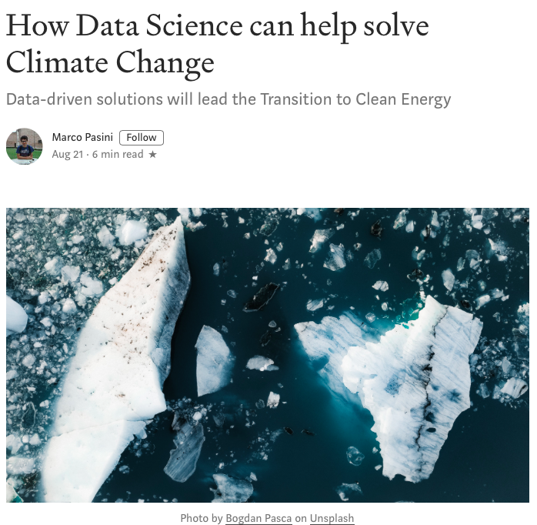
Data Science in Climate Control
https://towardsdatascience.com/how-data-science-can-help-solve-climate-change-12b28768e77b

Slide 20
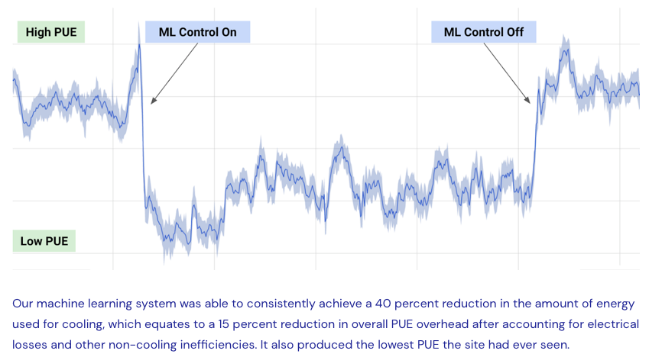
Data Science in Climate Control
https://deepmind.com/blog/article/deepmind-ai-reduces-google-data-centre-cooling-bill-40

Slide 21
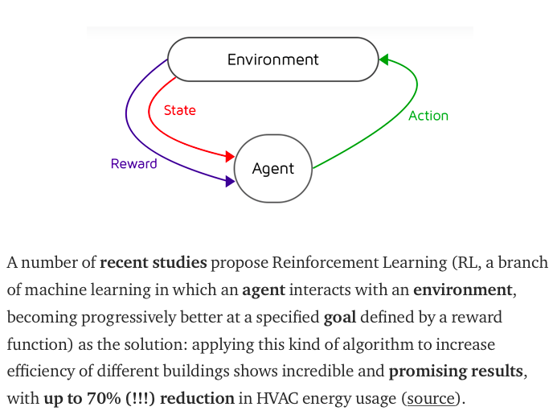
Data Science in Climate Control
https://ywang393.expressions.syr.edu/wp-content/uploads/2016/07/Deep-reinforcement-learning-for-HVAC-control-in-smart-buildings.pdf

Slide 22
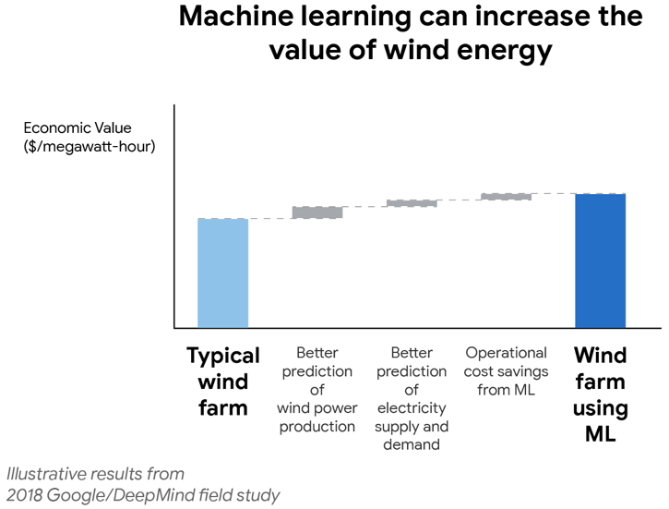
Data Science in Climate Control
https://deepmind.com/blog/article/machine-learning-can-boost-value-wind-energy

Slide 23
Getting Practical

Slide 24
Dataset: Country Statistics
World Bank data about 161 countries
Country Name
GDP per Capita (PPP USD)
Population Density (persons per sq km)
Population Growth Rate (%)
Urban Population (%)
Life Expectancy at Birth (avg years)
Fertility Rate (births per woman)
Infant Mortality (deaths per 1000 births)
Enrolment Rate, Tertiary (%)
Unemployment, Total (%)
Estimated Control of Corruption (scale -2.5 to 2.5)
Estimated Government Effectiveness (scale -2.5 to 2.5)
Internet Users (%)

Slide 25
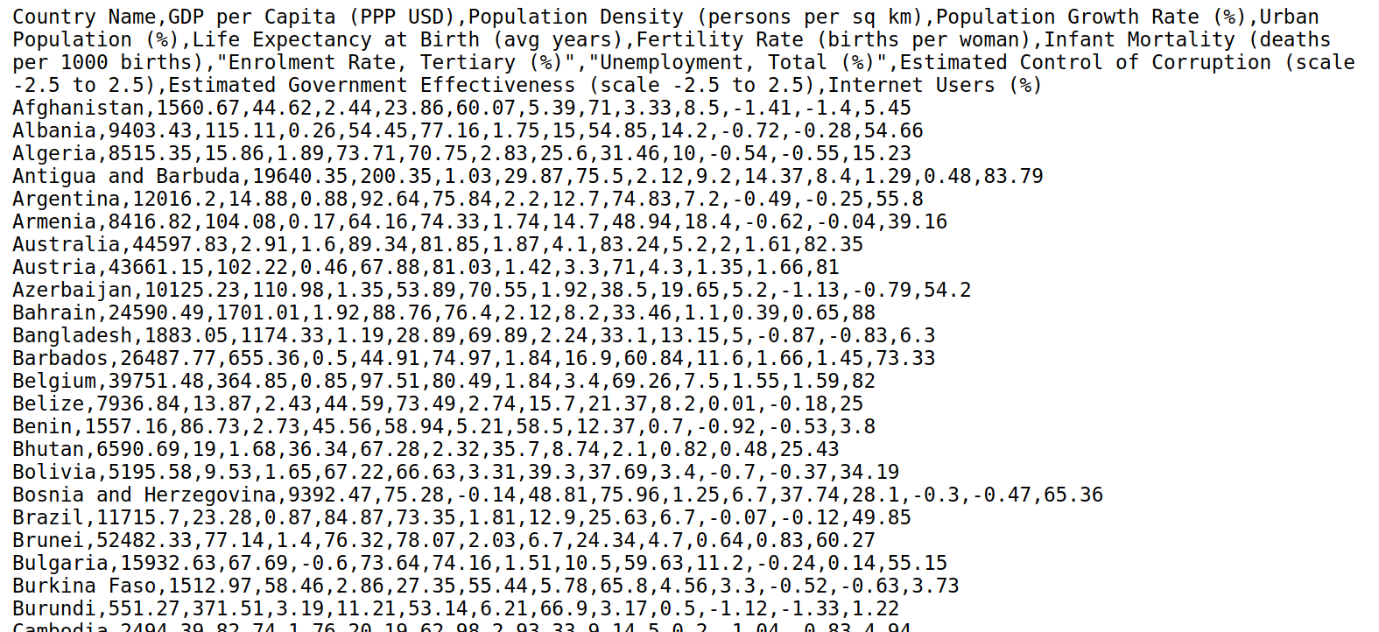
Dataset: Country Statistics

Slide 26

Using Python. Why Python?
Fast to write and modify
Great for working with datasets
Portable
Most machine learning research happens in python
Actually useful for other things besides data science
Dynamically typed (can cause run-time errors)
Not as fast as lower-level languages (sometimes)
Not good for unusual platforms
Notes:
https://www.tutorialspoint.com/python/index.htm
https://www.learnpython.org
https://www.codecademy.com/courses/learn-python

Slide 27
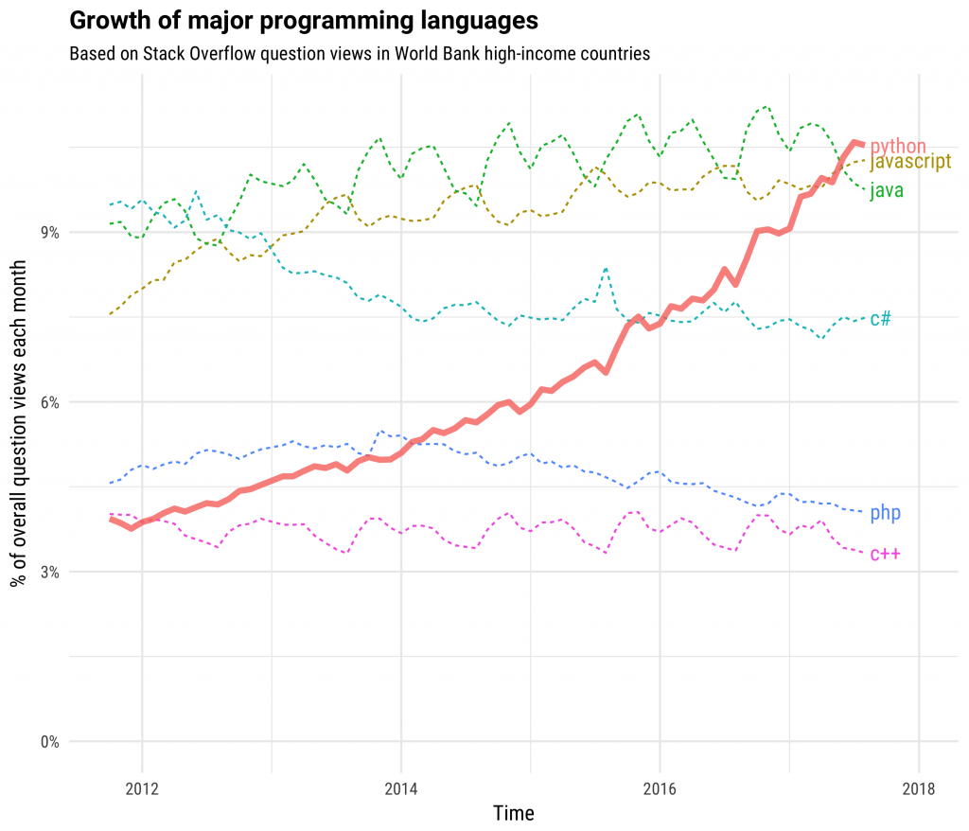
https://stackoverflow.blog/2017/09/06/incredible-growth-python/
Notes:
https://stackoverflow.blog/2017/09/06/incredible-growth-python/

Slide 28
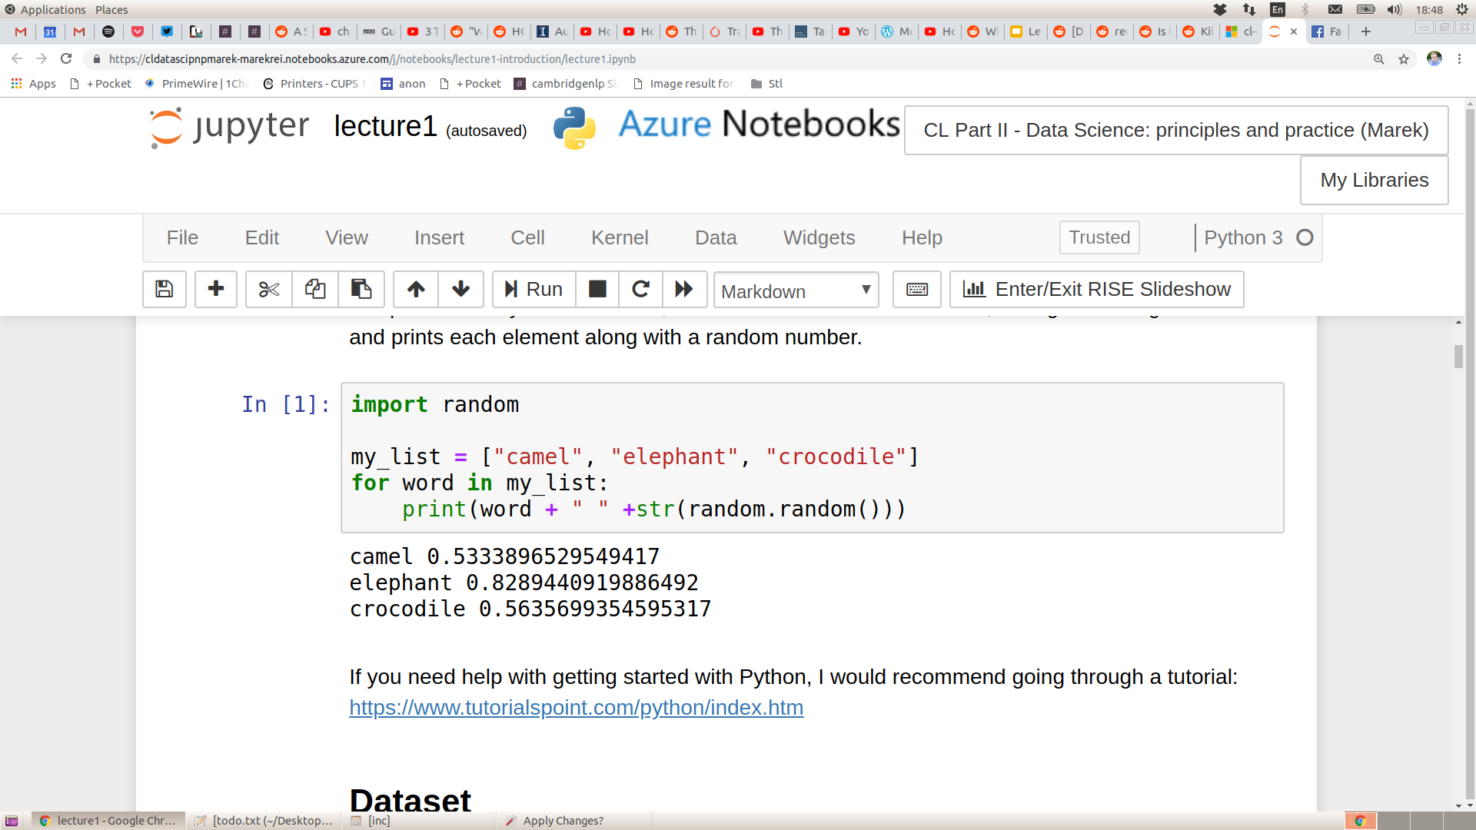
Python Refresher
Python tutorial: https://www.tutorialspoint.com/python/index.htm

Slide 29
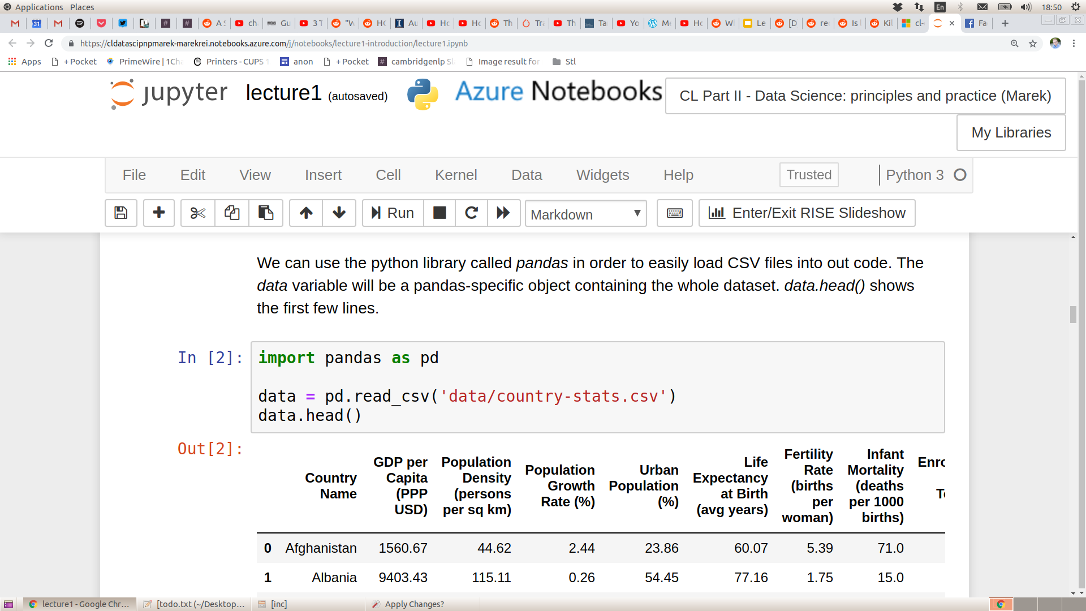
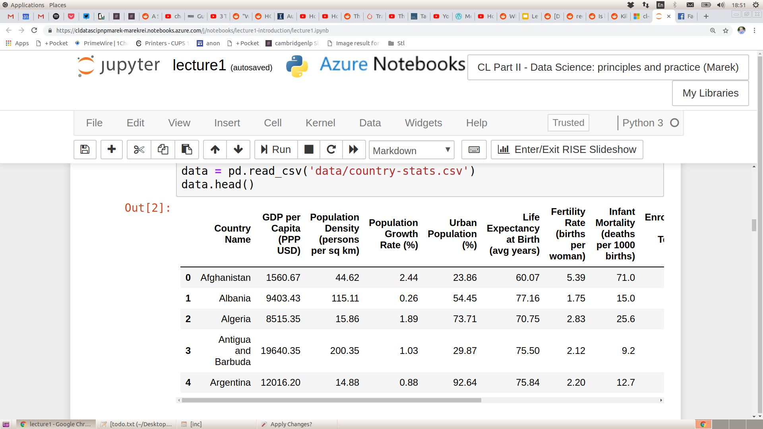
Loading CSV files
Notes:
Pandas = panel data
Loads into DataFrame

Slide 30
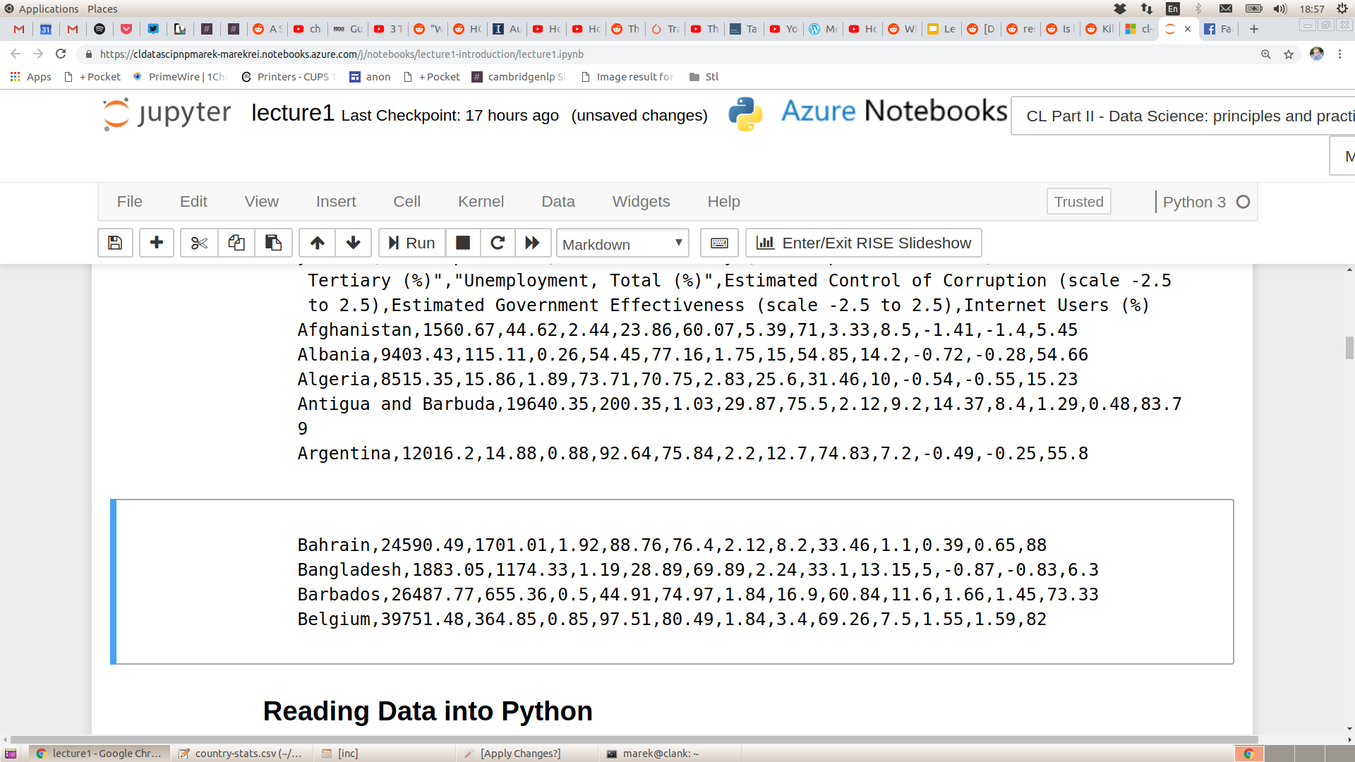
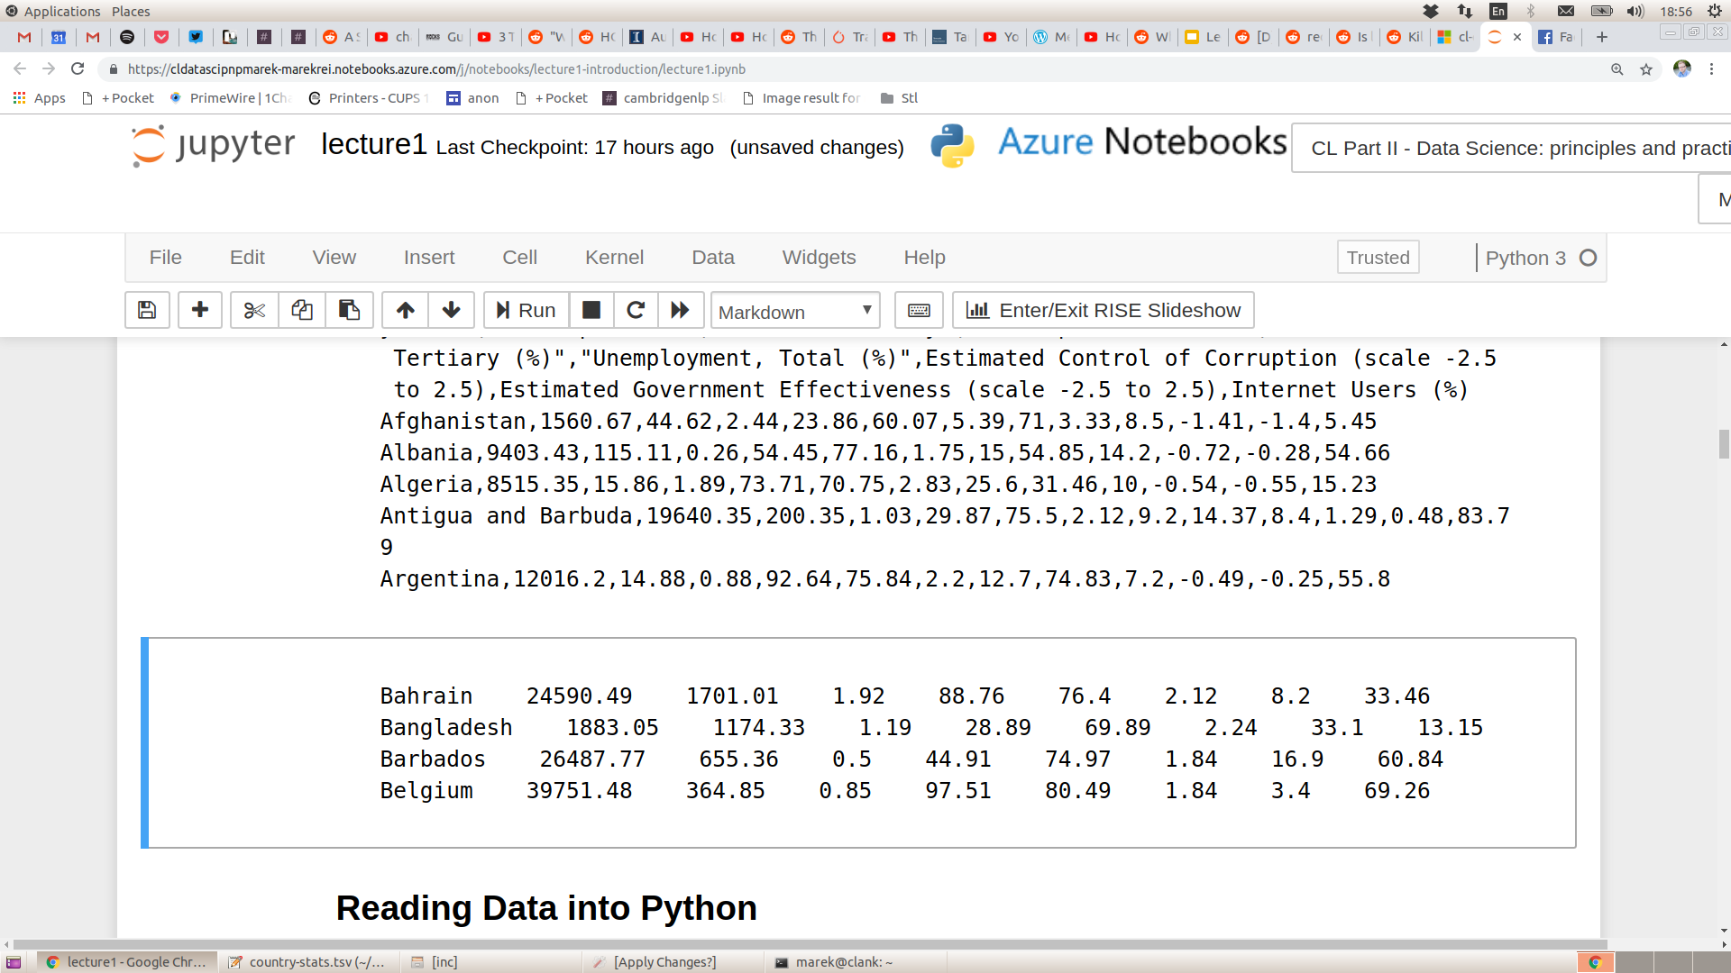
Common File Formats
CSV - comma-separated values
TSV - tab-separated values

Slide 31
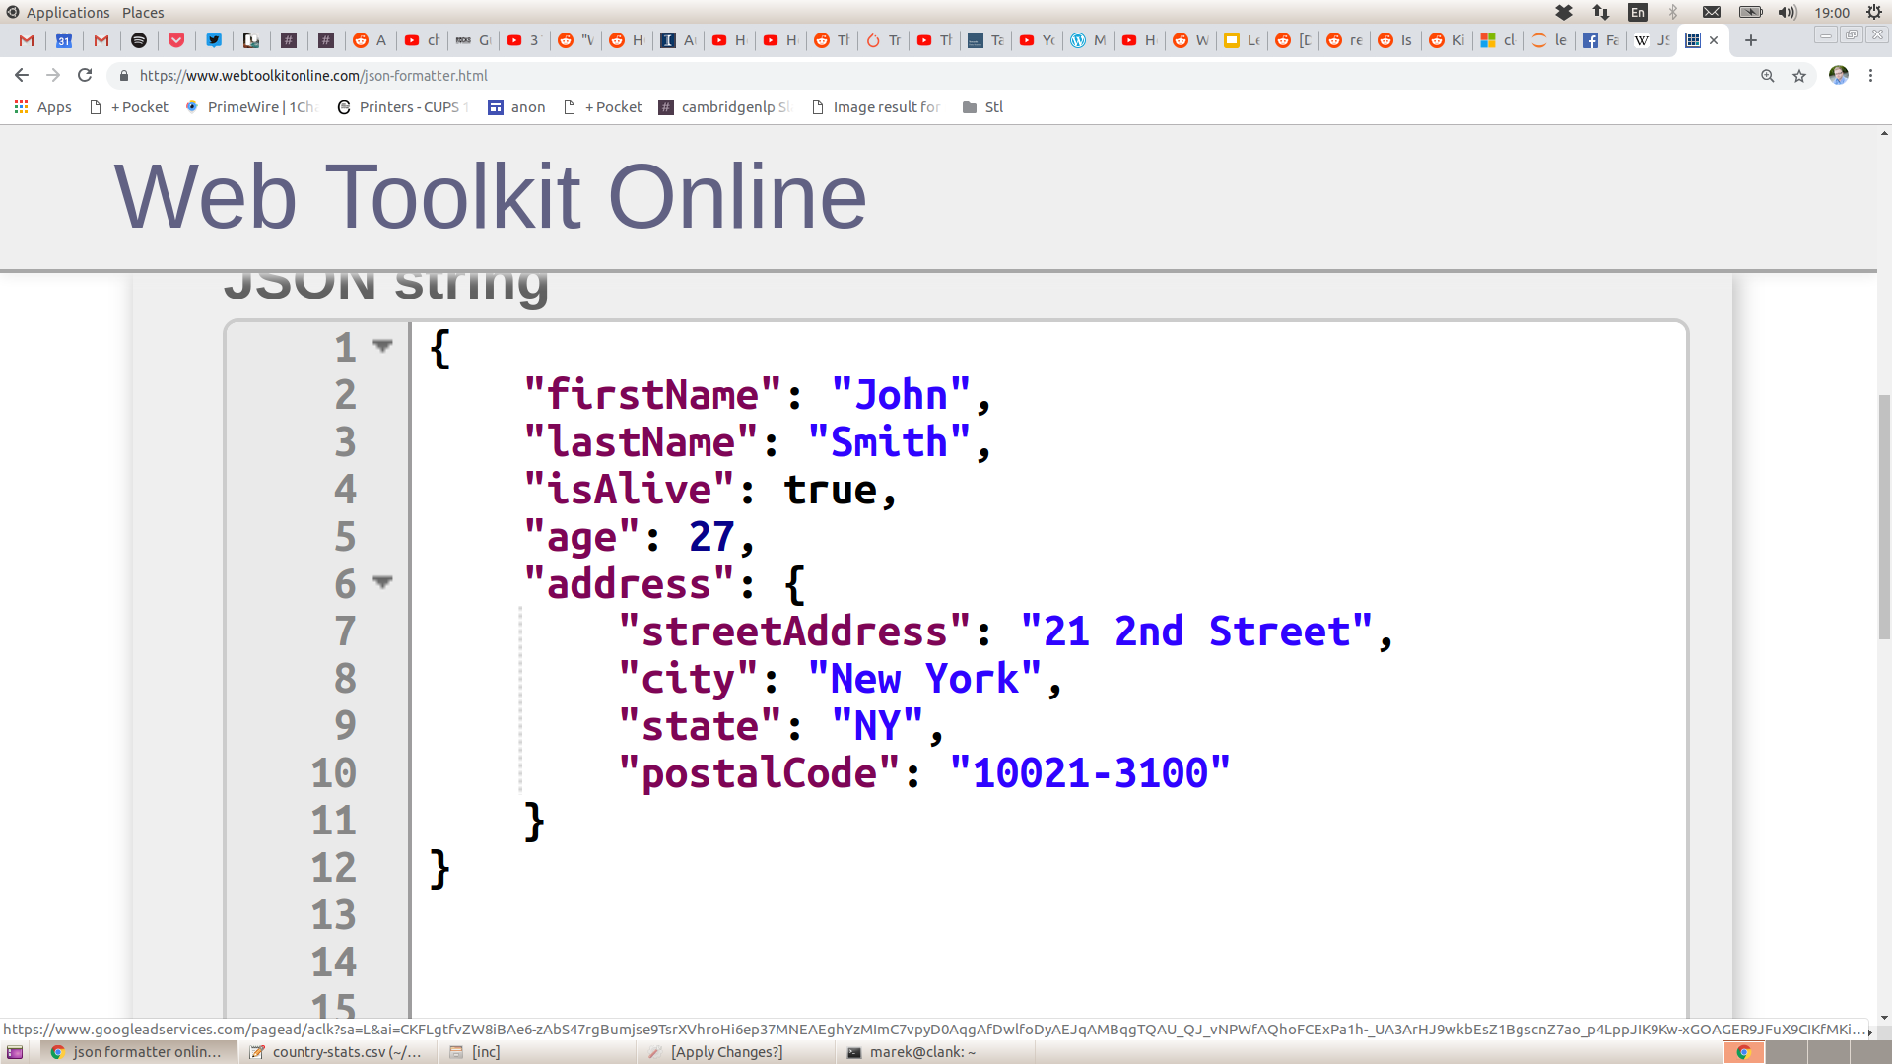
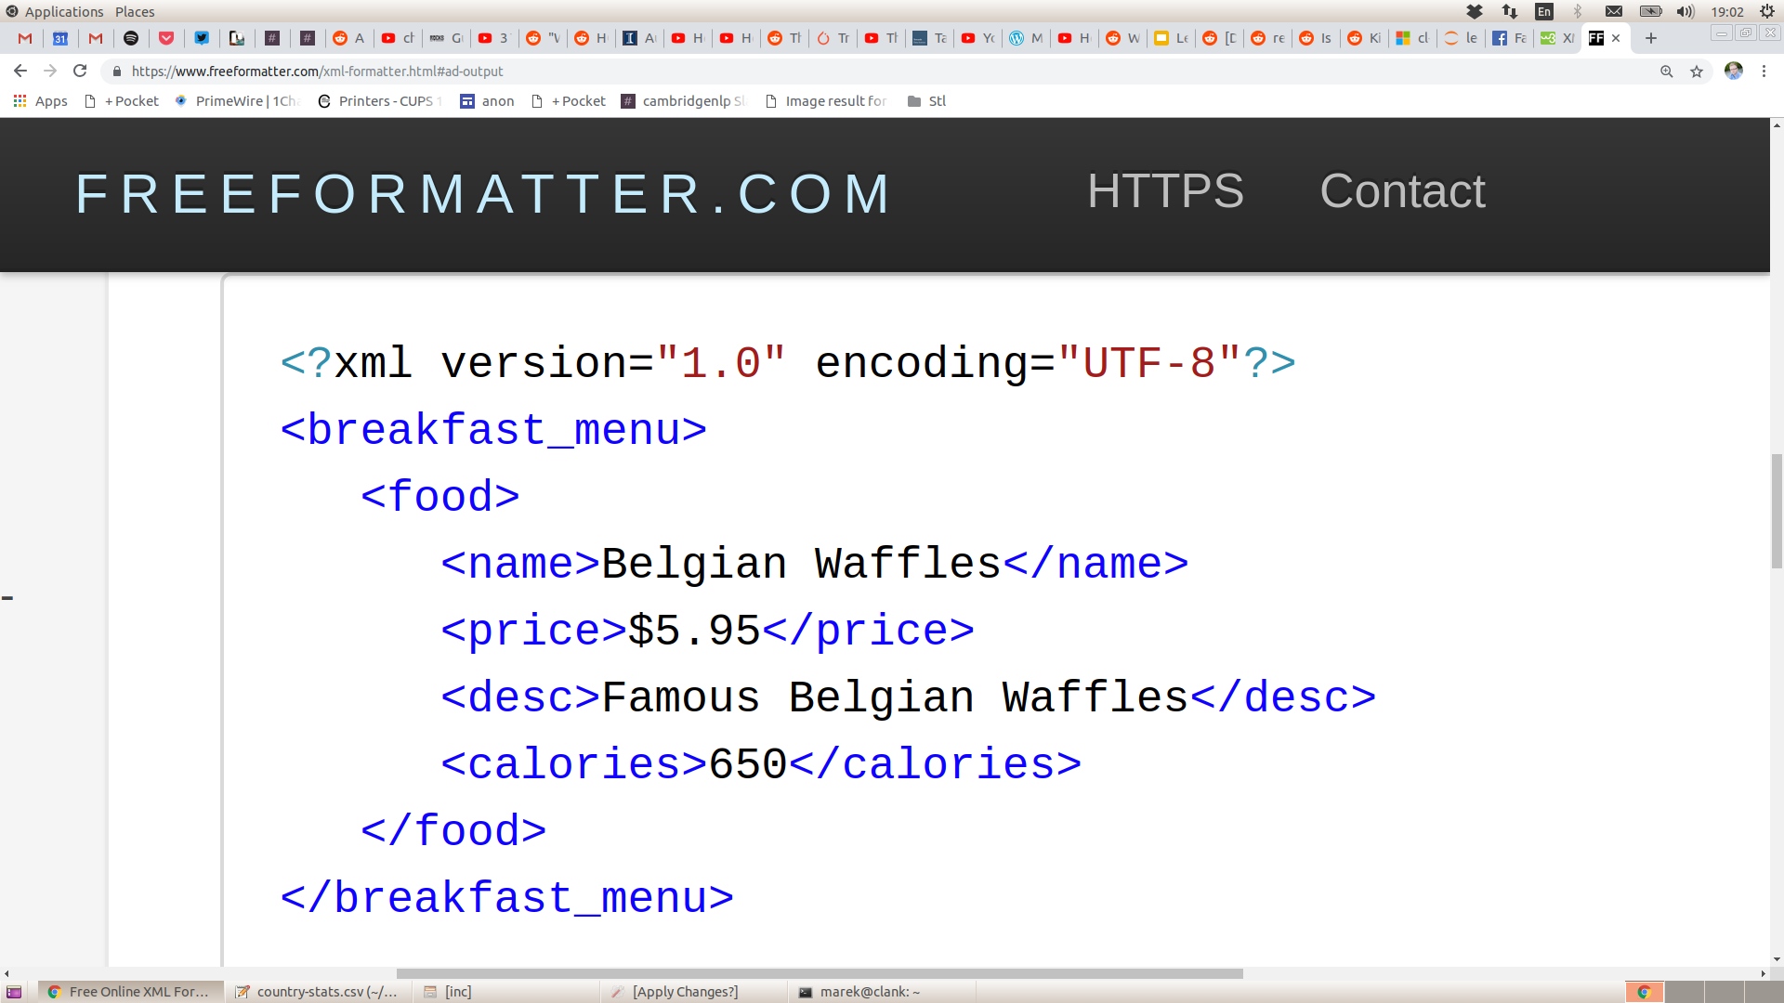
Common File Formats
JSON:
JavaScript Object Notation
XML: Extensible Markup Language

Slide 32
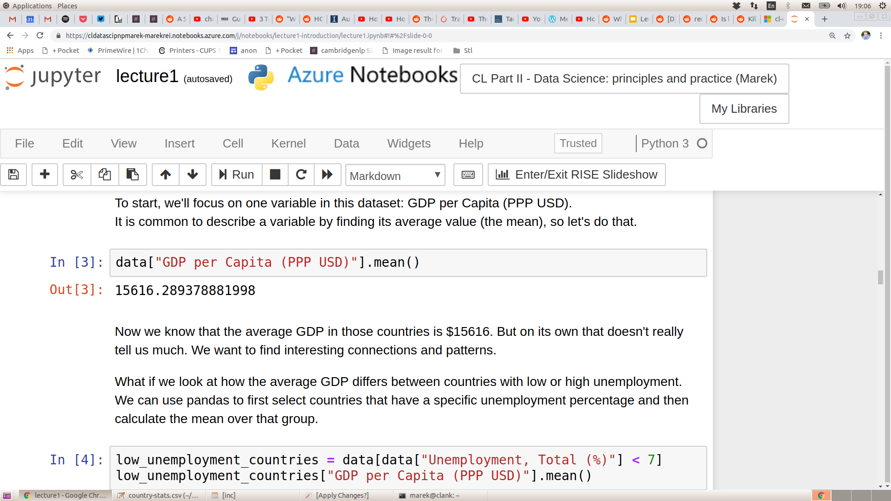
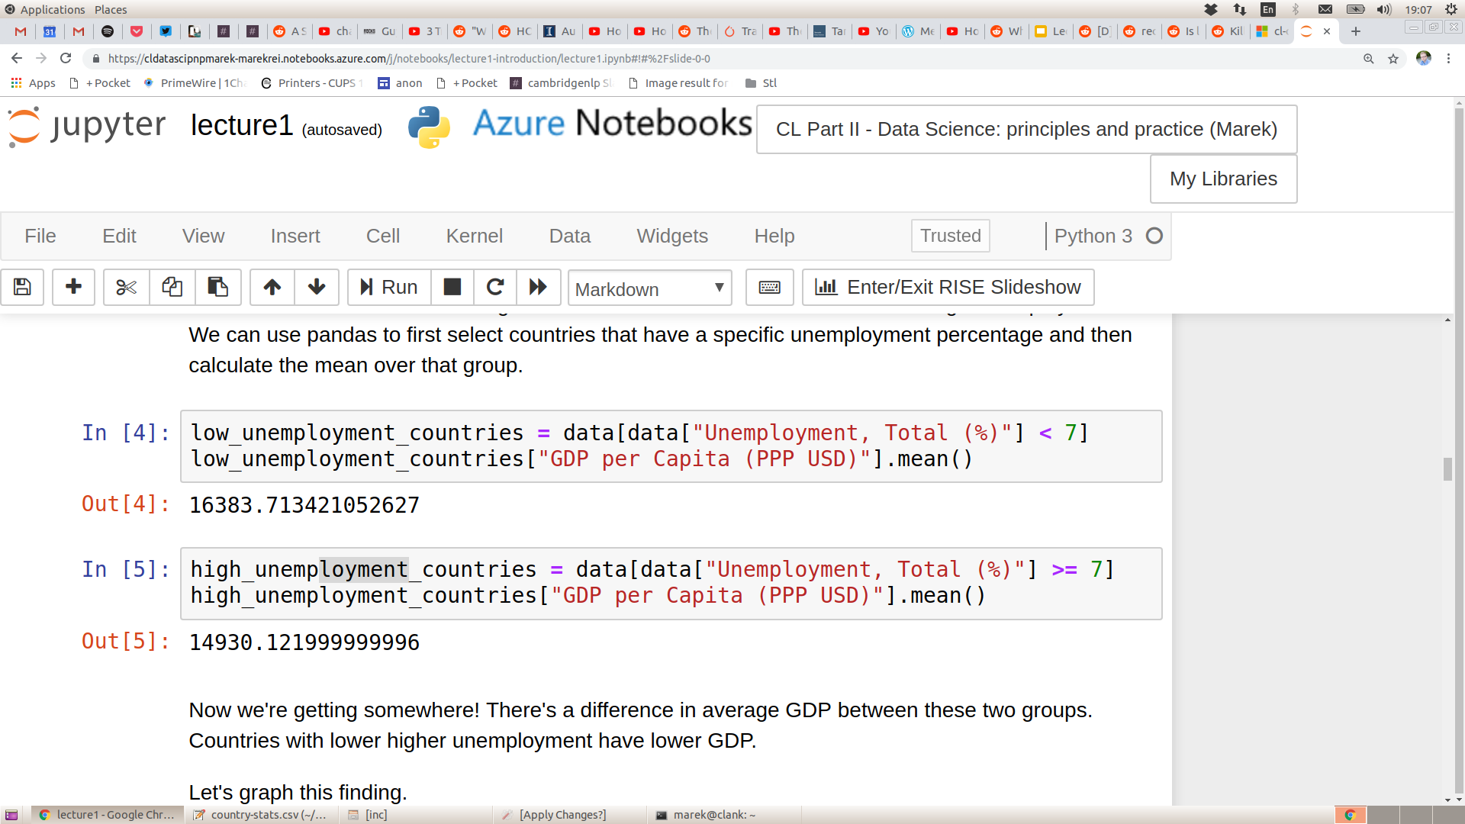
Calculating Statistics over the Data

Slide 33
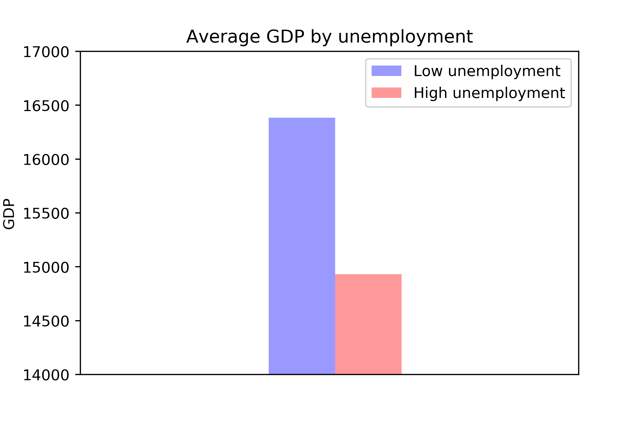
Calculating Statistics over the Data

Slide 34
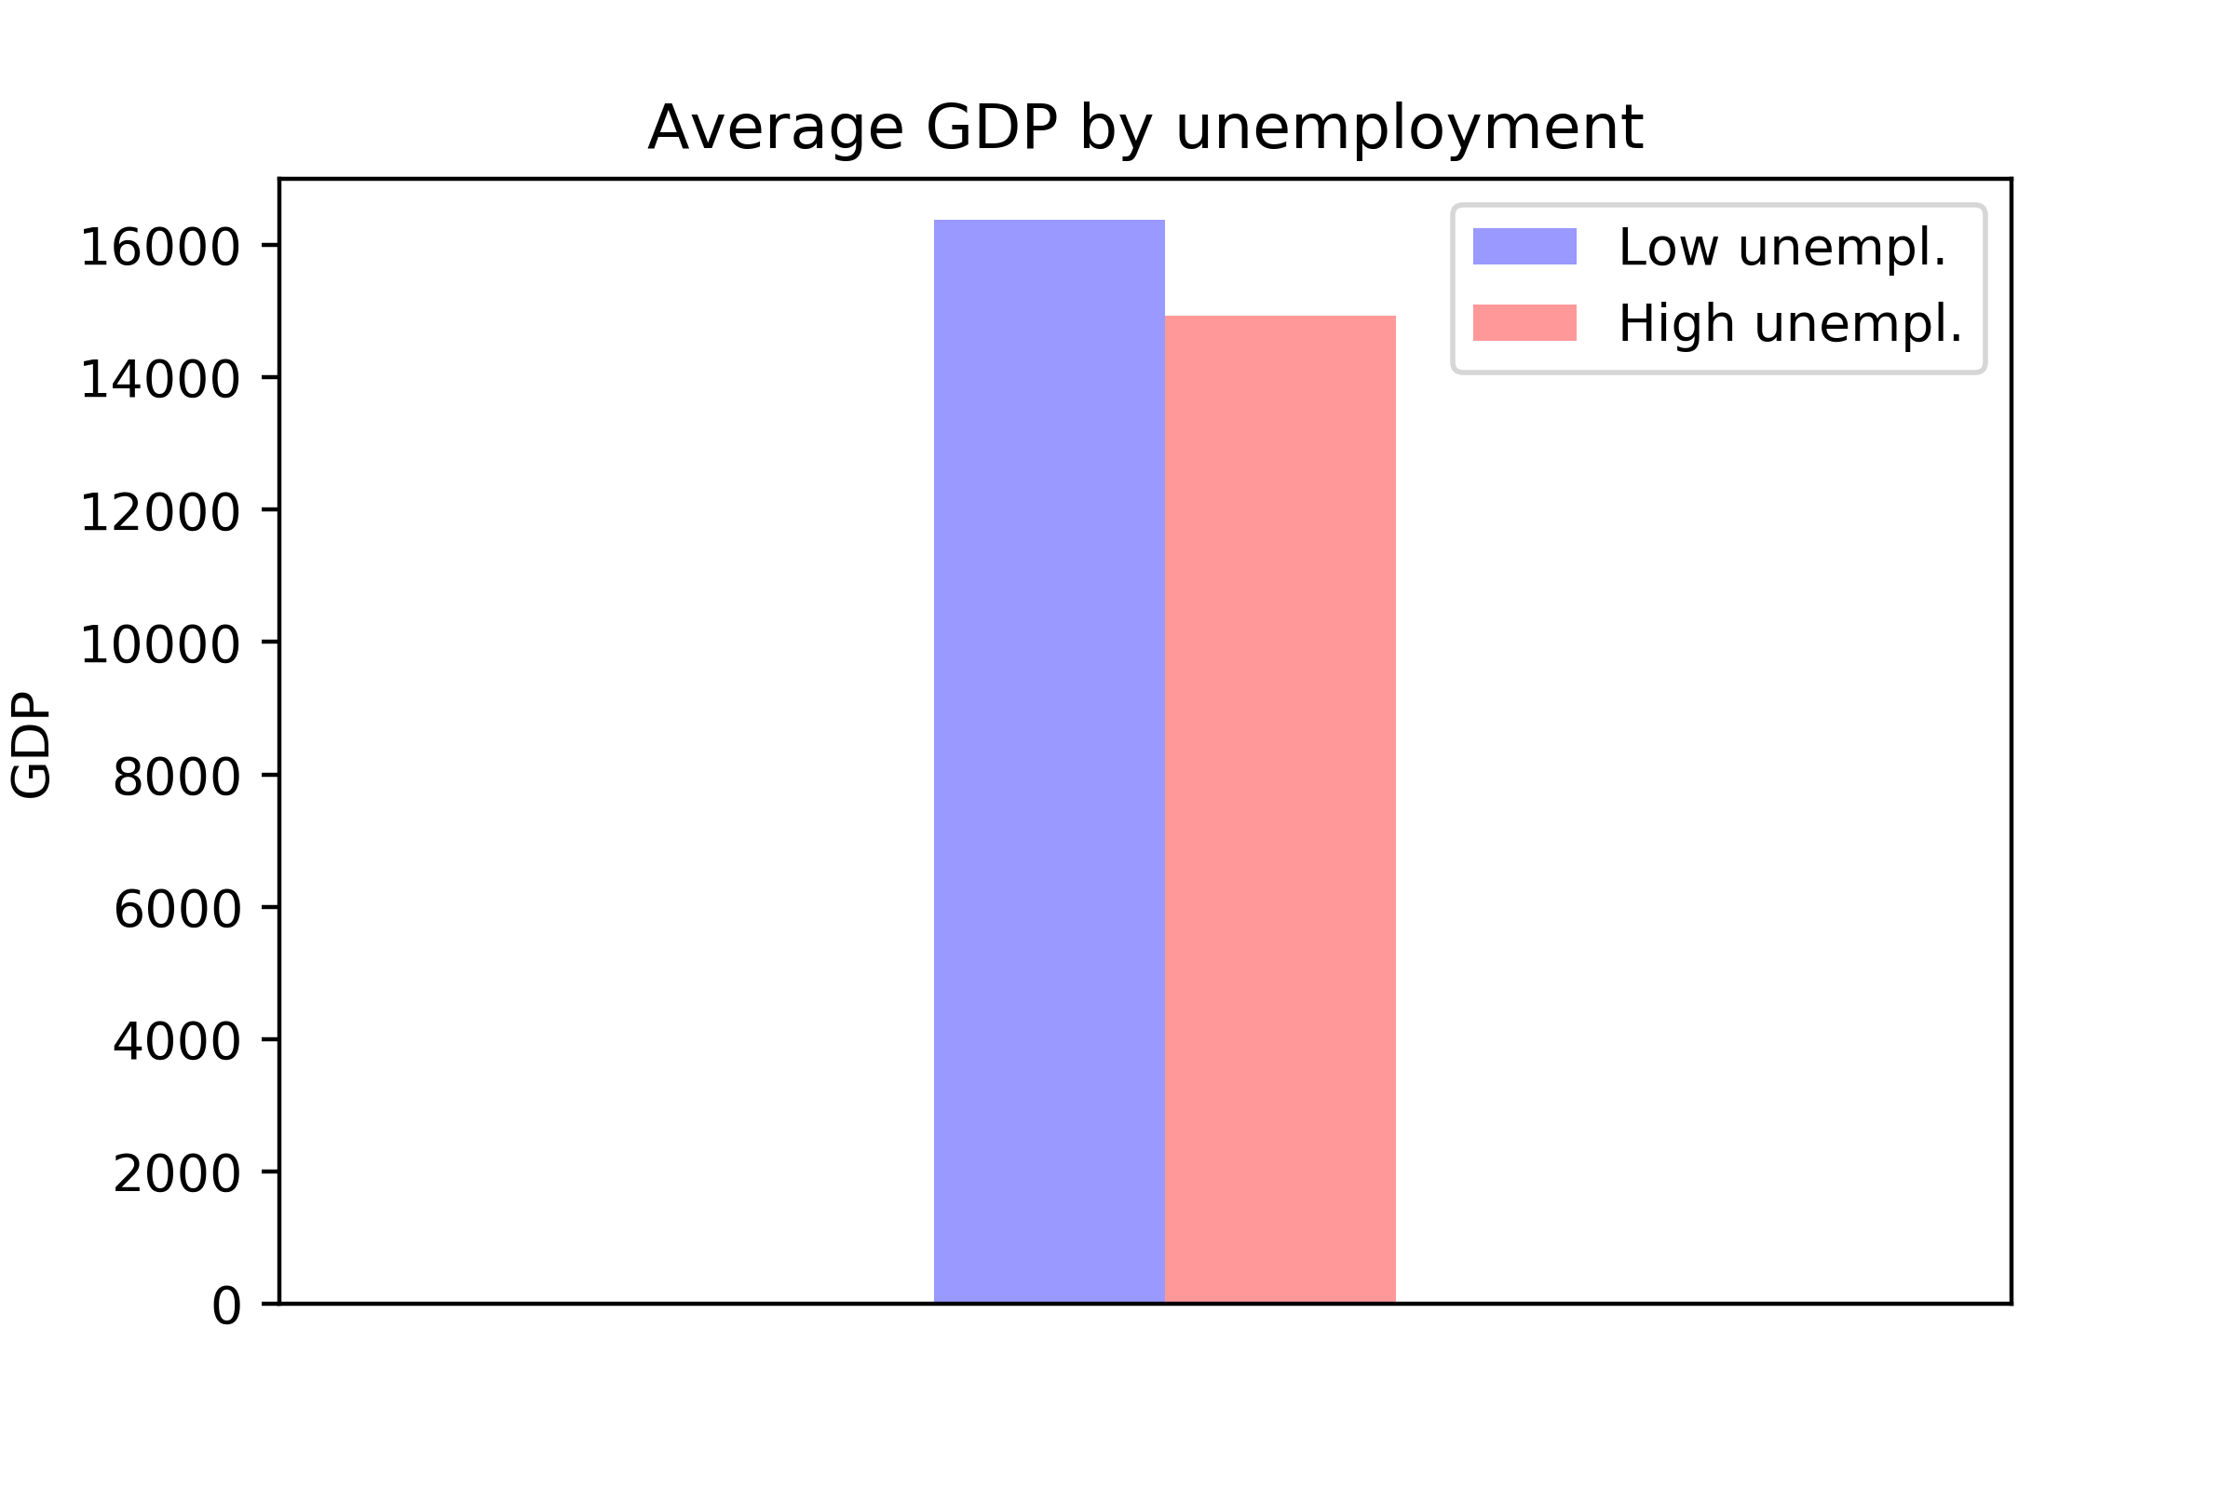
Calculating Statistics over the Data

Slide 35
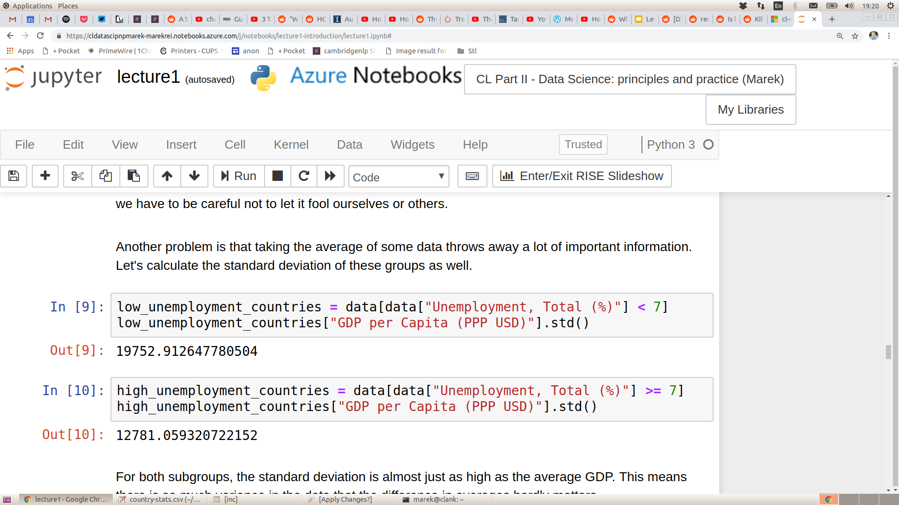
Calculating Statistics over the Data

Slide 36
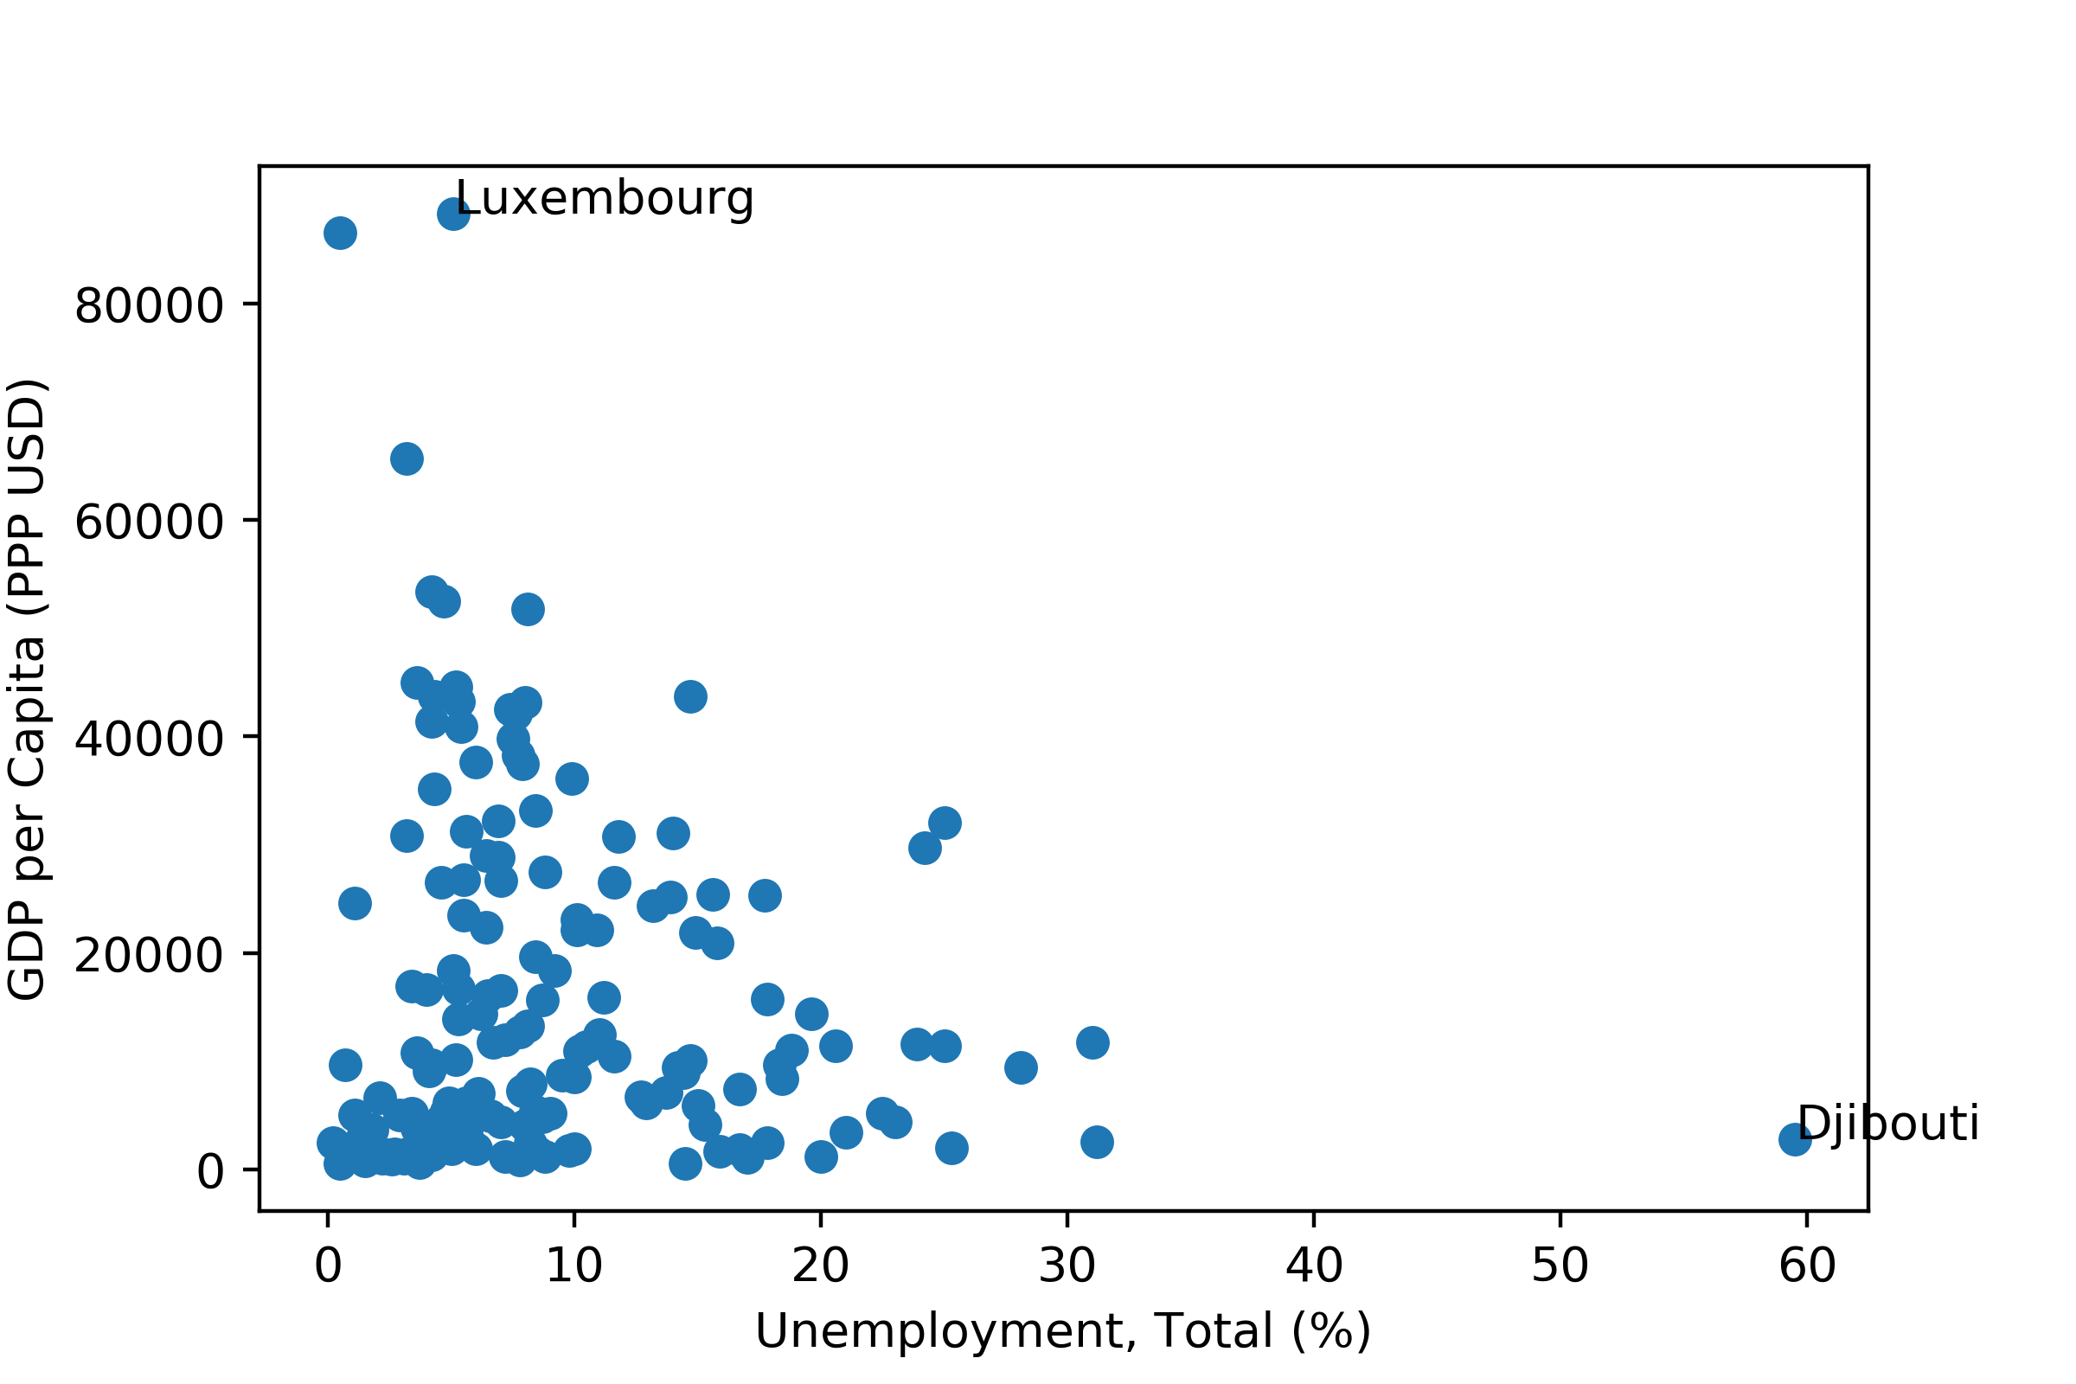
Calculating Statistics over the Data

Slide 37
Course Logistics

Slide 38
Course Objectives
Focusing on the practical aspects of data science
After this course you should be able to
Understand the principles of data science
Use the necessary software tools for data processing, statistics and machine learning
Visualize data, both for exploration and presentation
Rigorously analyze your data using a variety of approaches

Slide 39
Course Format
10 lectures
6 practicals
Assessment
20% from practicals (pass/fail)
80% from take-home assignment
Final assignment
Practical exercise
Given out after the lecture on 25 November
Submit a report
The report will be marked by two assessors

Slide 40
Course Syllabus
1. Introduction | Friday, 8 November
2. Linear Regression | Monday, 11 November
3. Practical1: Linear Regression | Tuesday, 12 November
4. Classification | Wednesday, 13 November
5. Practical2: Classification | Thursday, 14 November
6. Ensemble-based models | Monday, 18 November
7. Practical3: Ensemble models | Tuesday, 19 November
8. Visualization, part I | Wednesday, 20 November

Slide 41
Course Syllabus
9. Visualization, part II | Friday, 22 November
10. Deep Learning basics | Monday, 25 November
11. Practical4: Visualization | Tuesday, 26 November
12. Deep Learning with TensorFlow | Wednesday, 27 November
13. Practical5: Deep Learning I | Thursday, 28 November
14. Deep Learning architectures | Friday, 29 November
15. Challenges in Data Science | Monday, 2 December
16. Practical6: Deep Learning II | Tuesday, 3 December

Slide 42



Lecturers
Ekaterina Kochmar ek358
Guy Emerson gete2
Damon Wischik djw1005

Slide 43
Course Pages
Course homepage: https://www.cl.cam.ac.uk/teaching/1920/DataSciII/
Azure Notebooks: https://notebooks.azure.com/ek358/projects/data-science-pnp-1920
Getting started with Azure Notebooks: https://notebooks.azure.com/ek358/projects/data-science-pnp-1920/getting-started.ipynb
Github: https://github.com/ekochmar/cl-datasci-pnp

